Slide 1


Introduction
Vivek Pawar
Project Name :
StudyBuddy – AI-Driven Study Management & Mock-Test Platform

Slide 2
Introduction
StudyBuddy is an AI-powered learning management platform designed to help students organize study materials, create notes, take mock tests, and improve learning efficiency.
The system provides:
Digital notebook management
AI-assisted note generation
Community-based learning
Mock test creation and evaluation
Progress tracking and analytics
Teacher-student interaction
The platform aims to create a centralized environment where students can learn, practice, and monitor their academic performance effectively.

Slide 3
Aim & Objective
Aim :- To develop a database system that manages student placement activities and simplifies the recruitment process.
Objective :
Store student information
Maintain company records.
Manage placement drives.
Track student applications.
Generate placement reports.
Calculate placement percentage.

Slide 4
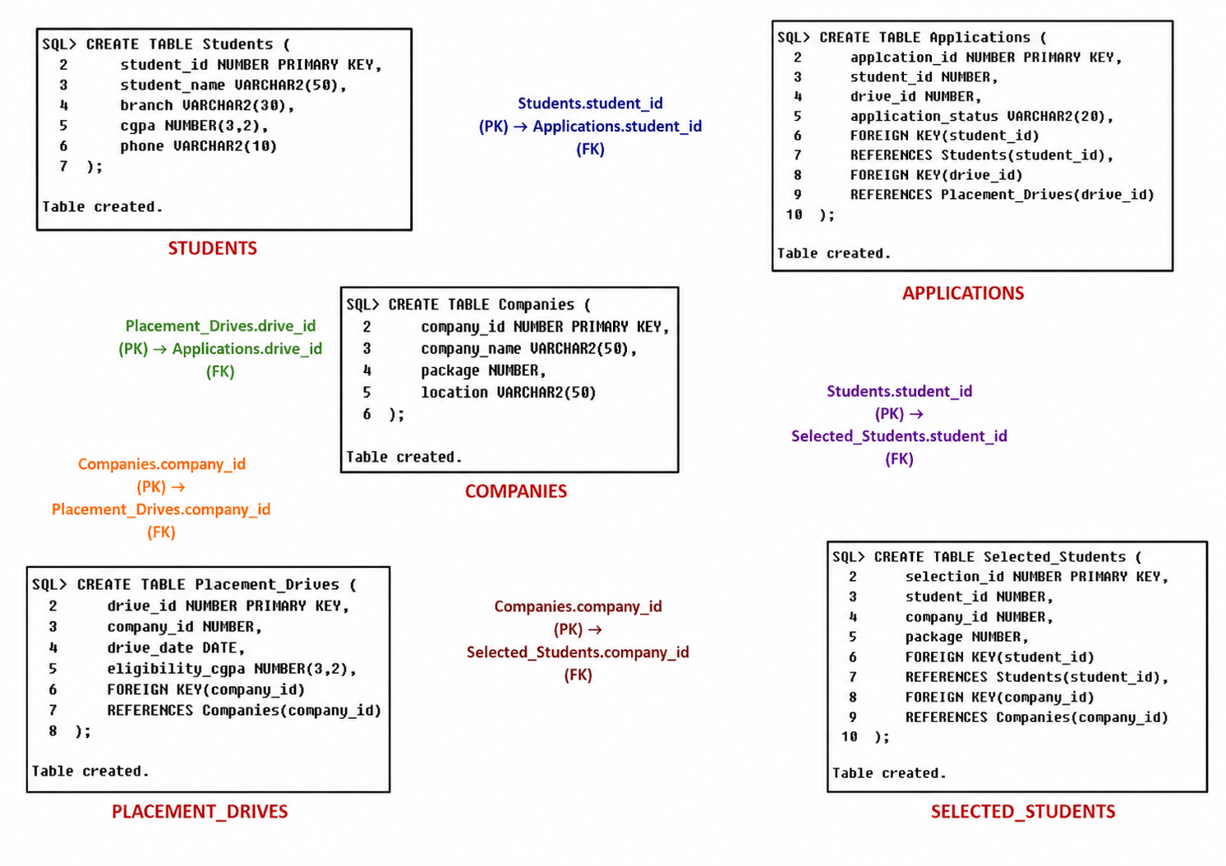
Database Design

Slide 5
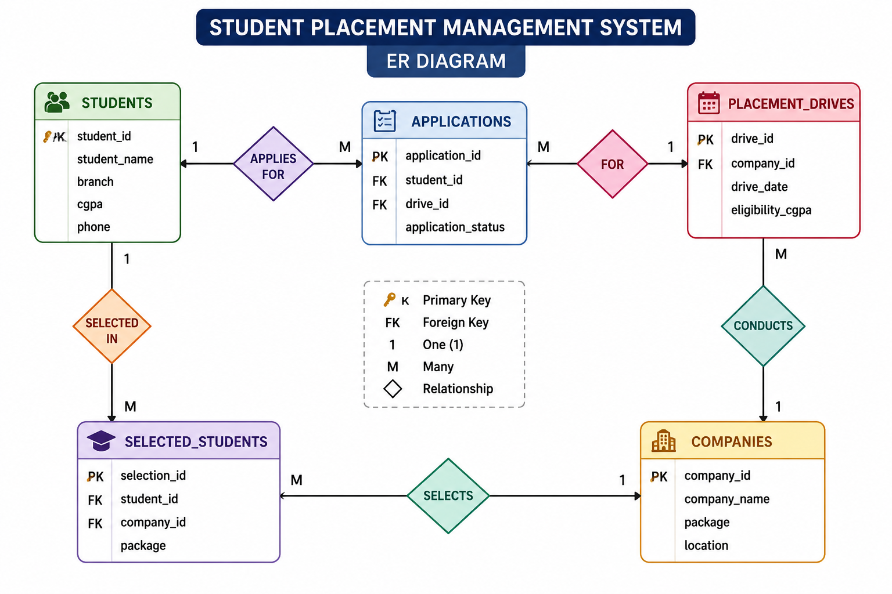
ER Diagram

Slide 6
Conclusion
The Student Placement Management System efficiently manages student placement activities, company recruitment drives, applications, and selections.
It reduces manual work and helps placement officers generate accurate placement reports quickly.

Slide 7


Thank you !
Nagpur | Pune | Jalgaon | Amravati | Pandhurna | Bhandara

